Slide 1
Mohamed Aathil
30415

Slide 2
EMPLOYEE LEAVE MANAGEMENT SYSTEM
This employee leave management system provides a platform where employees can submit leave requests, and managers can review and approve or reject those requests efficiently.
Employee can choose dates , types of leave and can view remaining leaves and history.
Manager can view the pending request and can either approve or reject with remarks and can see all his employees history and leave balances

Slide 3
Architecture used: Microservices
Services used : Employee , Manager , Gateway
Each service have their own database (Sqlite)
Services communicate over API’s through gateway.

Slide 4
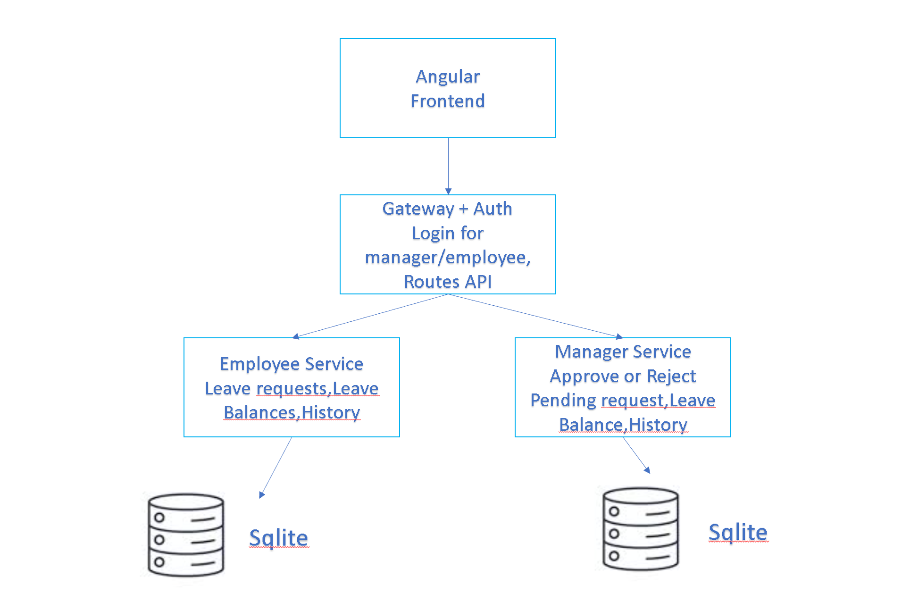

Slide 5
Services & API
Employee Service : Leave Request , Leave Balances, History
POST - /apply_leave → Employee applies for leave (pending by default)
GET - /my_leaves/<id> → Get all leave requests of a specific employee
DELETE - /delete_leave/<id> → Delete leave request (only if status is pending)

Slide 6
Services & API
Manager Service : Approve or Reject Leaves, Leave all employees leave balances, History
GET - /all_leaves → Get all leave requests (with employee details)
GET - /leave_requests → Get only pending leave requests (for approval)
PUT - /update_leave/<id> → Update leave status (approve/reject/pending) + adjust balances

Slide 7
Containerization
Four Containers :
lms-employee
lms-manager
lms-gateway
lms-frontend
volumes:
lms_employee_data
lms_manager_data

Slide 8
Deployment (Docker)
Create Docker images and launch the complete stack with Docker Compose in detached mode
Check service health status, then access the frontend through your browser
Log in with the default admin account to begin setting up employees, managers, and leave details
Data remains safe between restarts because it is stored in persistent volumes

